Slide 1


Slide 2
BANKING ANALYSIS USING SQL
SAHIL DS-08

Slide 3
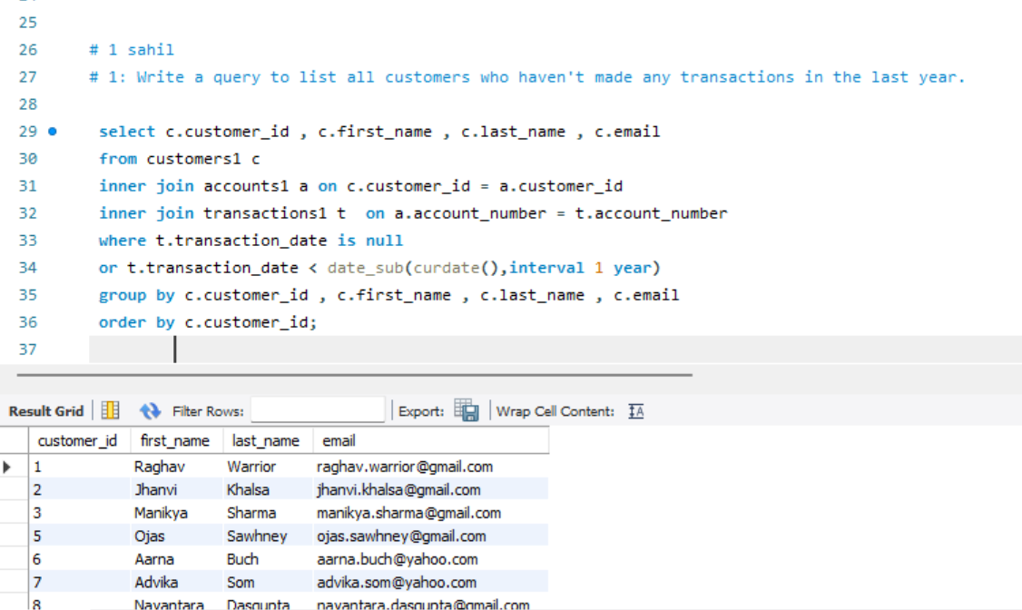
1: Write a query to list all customers who haven't made any transactions in the last year. How can we make them active again? Ans = 1 .targeted promotions : offer location specific discounts or deals relevant to their area: 2. local events : if your business has a regional presence , invite them to local events or promotions

Slide 4
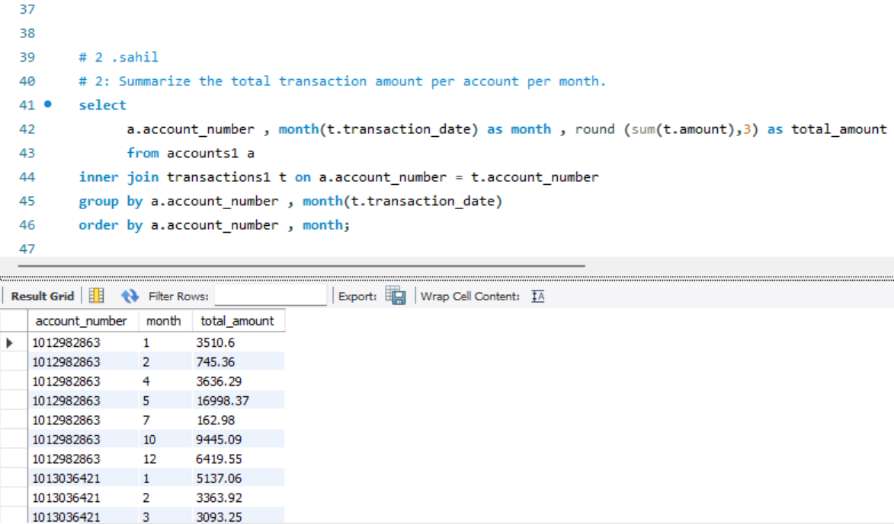
2: Summarize the total transaction amount per account per month.

Slide 5
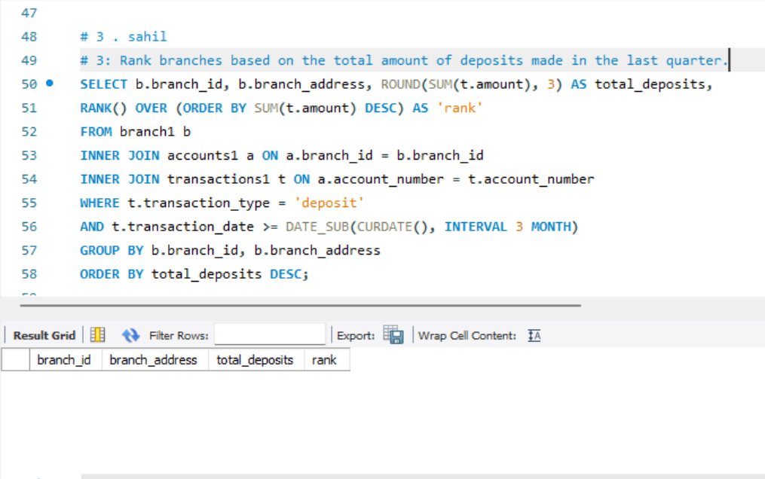
3: Rank branches based on the total amount of deposits made in the last quarter.

Slide 6
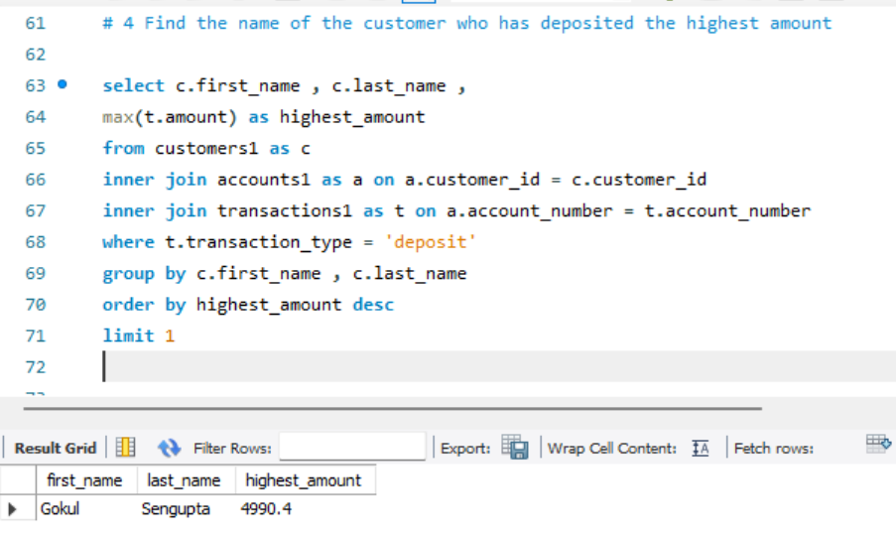
4: Find the name of the customer who has deposited the highest amount.

Slide 7
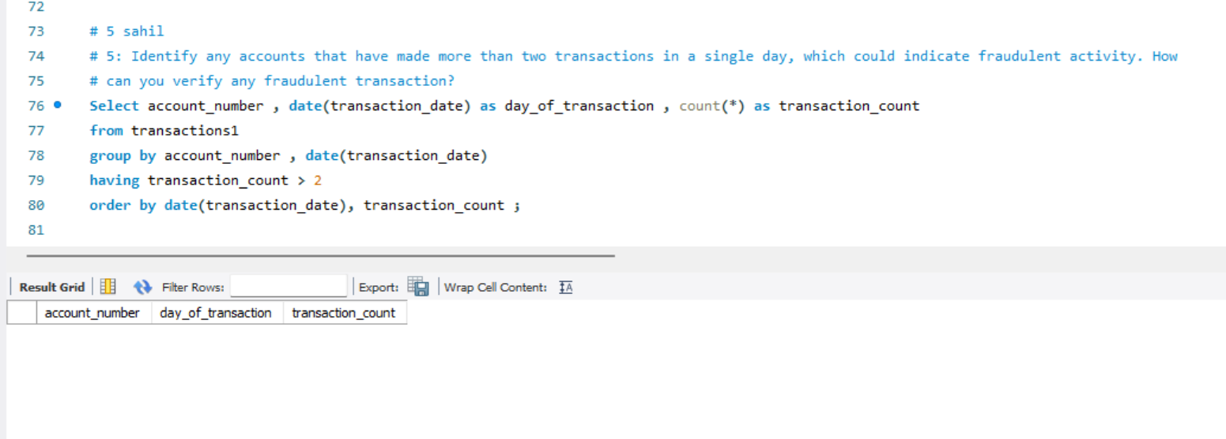
5: Identify any accounts that have made more than two transactions in a single day, which could indicate fraudulent activity. How can you verify any fraudulent transaction? 1. Transaction Monitoring: 2. Velocity Checks: 3. Email and Device Validation:

Slide 8
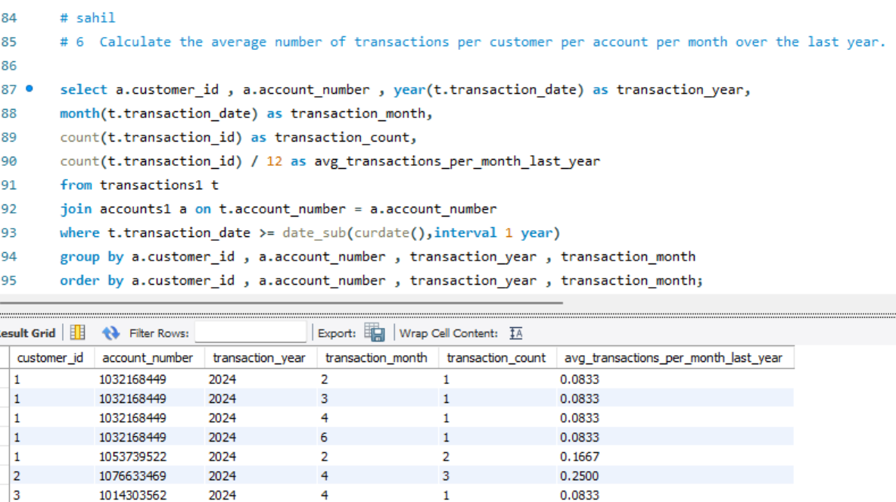
6: Calculate the average number of transactions per customer per account per month over the last year.

Slide 9
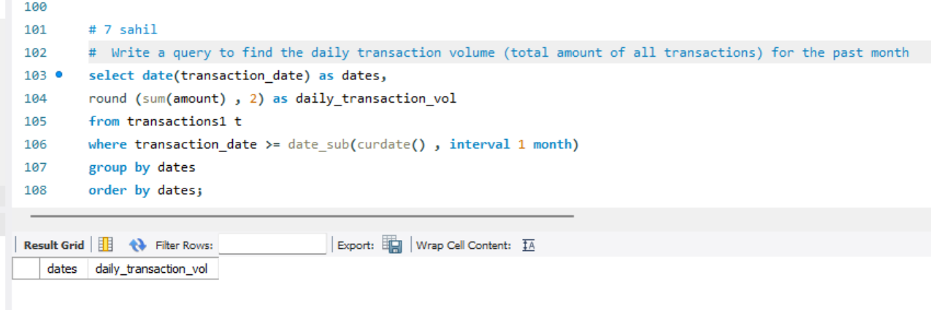
7: Write a query to find the daily transaction volume (total amount of all transactions) for the past month.

Slide 10
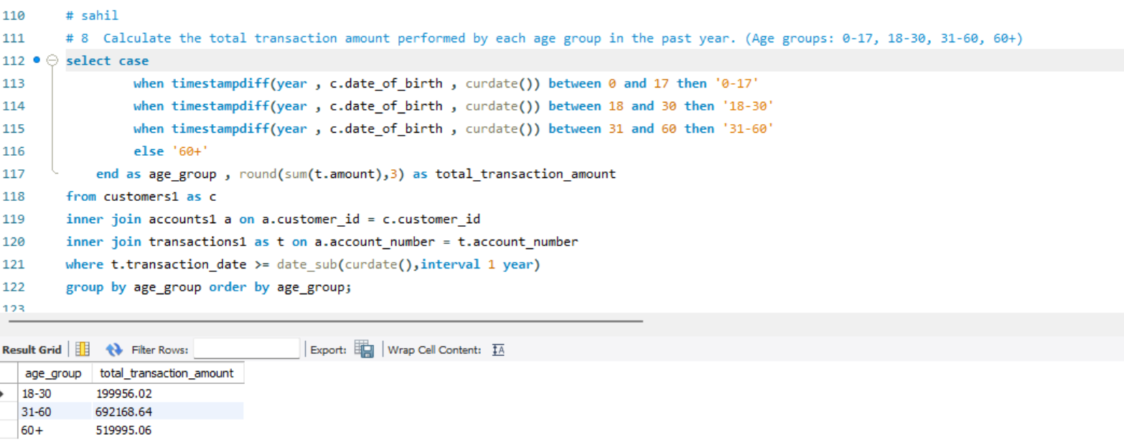
8: Calculate the total transaction amount performed by each age group in the past year. (Age groups: 0-17, 18-30, 31-60, 60+)

Slide 11
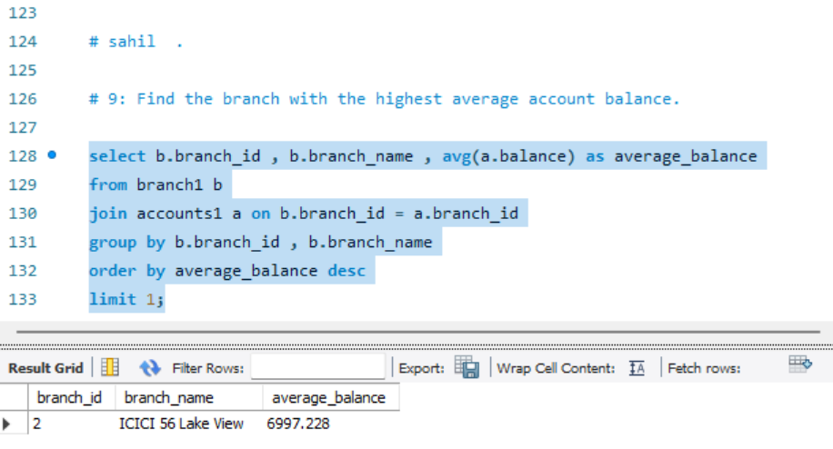
9: Find the branch with the highest average account balance.

Slide 12
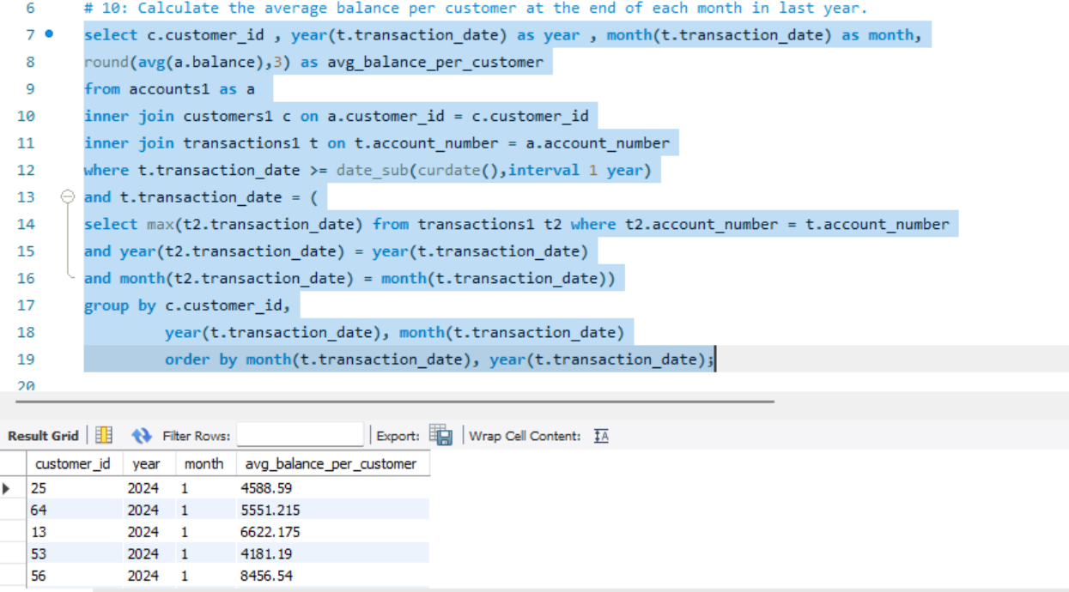
10: Calculate the average balance per customer at the end of each month in last year.

